Slide 1



Physical Properties of Spectroscopically-Confirmed z>6 Galaxies
By Charles Griffin
With special thanks to Dr. Eiichi Egami, and Dr. Benjamin Clément
NASA Space Grant Symposium, University of Arizona,
April 12, 2014

Slide 2
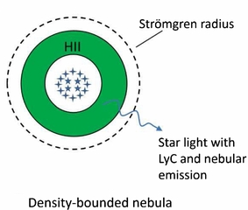
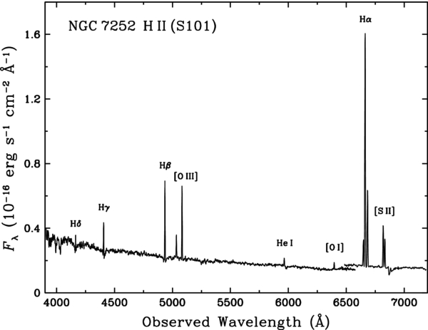
Scientific Motivation
Young massive stars emit UV photons
Ionize surrounding hydrogen
Ionized gas emits nebular emission lines
Galaxy Spectrum = continuum (stars) + nebular
emission lines (HII) regions
Source: Schweizer et Al.
Source: Zackrisson et Al.
Spectrum from HII region
SED plots of brightness v wavelength
Can be used to determine mass, star
formation rate, elemental abundances, etc…
Source: NASA/ESA

Slide 3
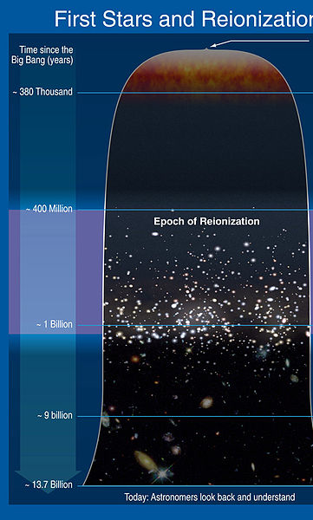
Objective
Improve SED modeling of high-z galaxies with nebular emission lines
Expansion causes redshift
z>6, when the universe was <10% of its current age, Reionization
Most Distant Galaxies
Source: EMC.com

Slide 4
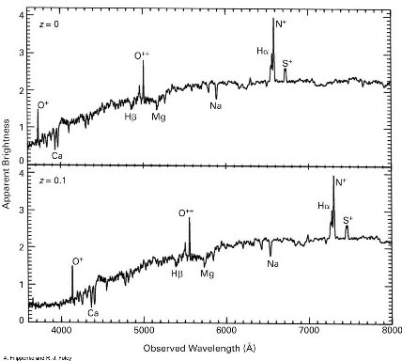
Redshift
Redshift increases wavelength of spectra
z>6 UV/Optical (stars/nebular emission) redshifted to IR (µm)
Atmosphere blocks IR radiation
No space spectrograph
Source: ScriptPHD.com

Slide 5
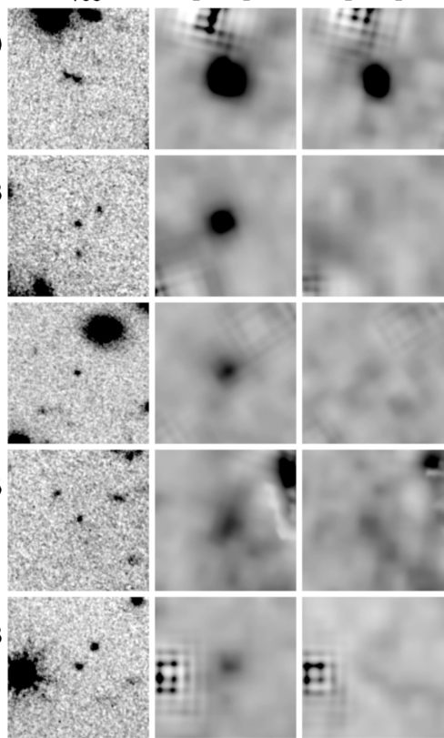
Unusual Brightness at 3.6 µm
Source: Smit et Al.
160µm 3.6µm 4.5µm
z=6.9
z=6.8
z=6.7
z=7.0
z=6.9
Filters measure the energy around some central wavelength
3.6µm filter is brighter than continuum models predict

Slide 6
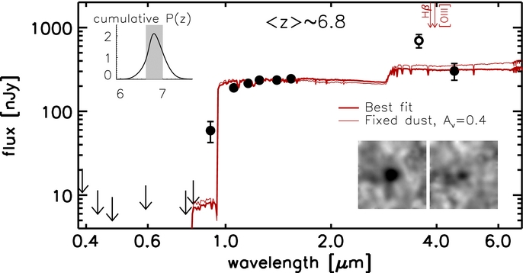
Bad fit at 3.6µm
Source: Smit et Al.
Light bluer than Lyman Alpha absorbed by Hydrogen in IGM
Continuum models too dim at 3.6µm

Slide 7
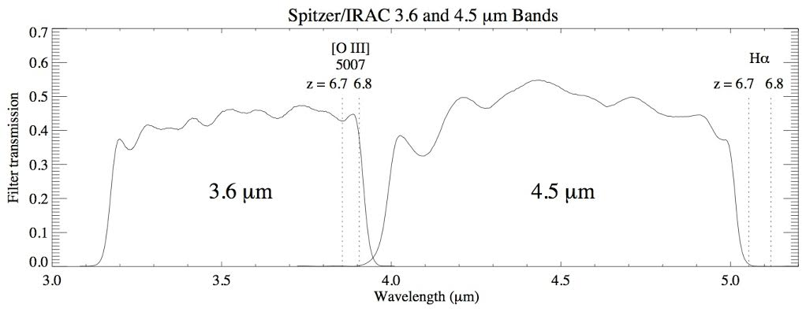
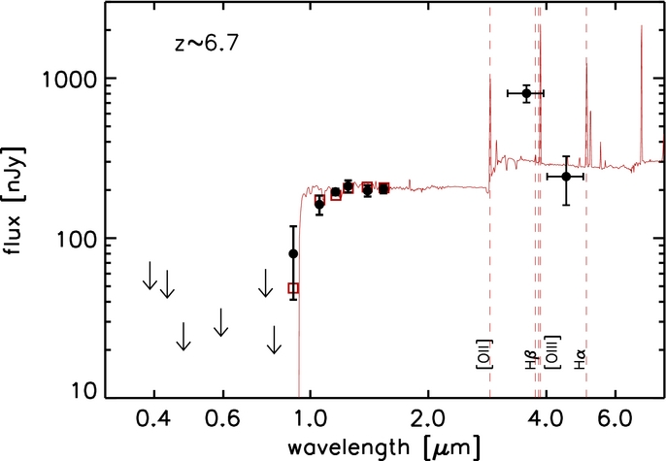
Resolved with Nebular Lines
Source: Smit et Al.
Nebular Emission [OIII] falls into 3.6µm filter
Increases brightness in 3.6µm filter

Slide 8
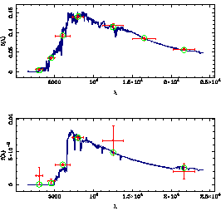
SED Modeling with Hyper-Z
Fits measurements to various synthetic SEDs
Minimizes Distance from measurement to SED
Width of measurement is range of wavelengths in filter
Source: Bolzonella et Al.
Notes:
*maybe Spire?

Slide 9
Nebular | Mass(M⦿) | Age(Myr) | SFR(M⦿/yr) | Chi^2
Off | 3.0*10⁹ | 1000 | 2.2 | 6.9
On | 1.3*10⁸ | 6.3 | 21 | 1.2
Balmer
Break
Rest Frame: UV Optical
Without Nebular Emission Lines
z=6.6
Too dim at 34µm
With Nebular Emission Lines
Better fit
Hydrogen-Alpha boosts 34µm

Slide 10
Results (z=6.96)
Large
Balmer
Break
Steep UV Slope
None of the SEDs in the Hyper-Z catalog produced a good fit

Slide 11
Interpretation
Steep UV slope, young stellar population
Large Balmer break, much older stellar population
Suggests multiple eras of star formation
Most distant known galaxies are more like our Milky Way than we thought
UV Slope

Slide 12
Summary
Future Work
Spitzer Space Telescope’s 3.6 and 4.5 bands could possibly be contaminated with strong nebular line emission
Including the effects of nebular line emission improves SED modeling
Some measurements suggest that galaxies experience multiple eras of star formation as early as z~7
Account for multiple epochs of stellar formation in high redshift galaxies, by including model SEDs of galaxies with more than one era of star formation.
Spectroscopy with the James Webber Space Telescope

Slide 13
Thank you!
Credits to:
  Dr. Eiichi Egami (Steward Observatory)
  Dr. Benjamin Clément (Steward Observatory)

